Slide 1

7COM1079-2024 Student Group No: A_group Names of Student Attendees: ……………………………..
……………………..
Group Name: A_group Name of Student Presenting: …………………..
Research Question : Is There is a Correlation Between COVID-19 Confirmed Cases and Death Ratio around the World.?

Slide 2
2
Dataset URL: and DS162
Our Independent variable is: This Independent variable datatype is : Confirmed
Our Dependent variable is: This Dependent variable datatype is : Deaths
Notes:
Before specifying your Research Question you must define the type of data you are analysing. Are the variables you select interval data (measurement data you can divide, multiple, etc), OR are they ordinal (there is a definite order but the intervals between each variable are not necessarily equal, or the terms might be subjective like in a likert scale); OR are they just categorical/nominal (Items such as film names, cities, etc., that you can count numbers of occurrences? You also need to understand whether the variable is either dependent or independent and this will vary according to the context. Independent variables may cause an effect, whereas the dependent variable might be effected by the independent variable. Check the lecture notes on the RQ for more information and examples.
You will get only one opportunity to present your Research Question ahead of the submission date. Have your questions ready, and be ready to take notes on feedback.
2

Slide 3
7COM1079-2024 Student Group No: a_group135
3
Our Research Question is
Null hypothesis (H_{o}): There is no Between COVID-19 Confirmed Cases and Death Ratio around the World.?
Alternative hypothesis (H₁); There is a Between COVID-19 Confirmed Cases and Death Ratio around the World.?
Notes:
3

Slide 4
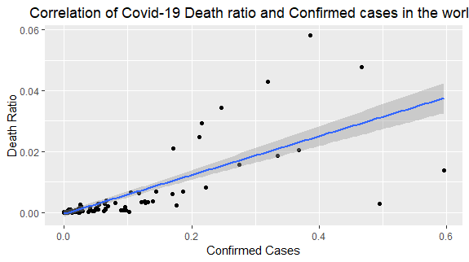
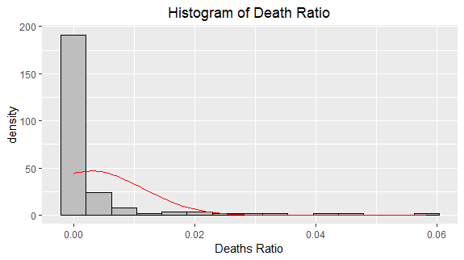
Visualization :: A_group135 Name of Student Presenting: ………………………..

Slide 5
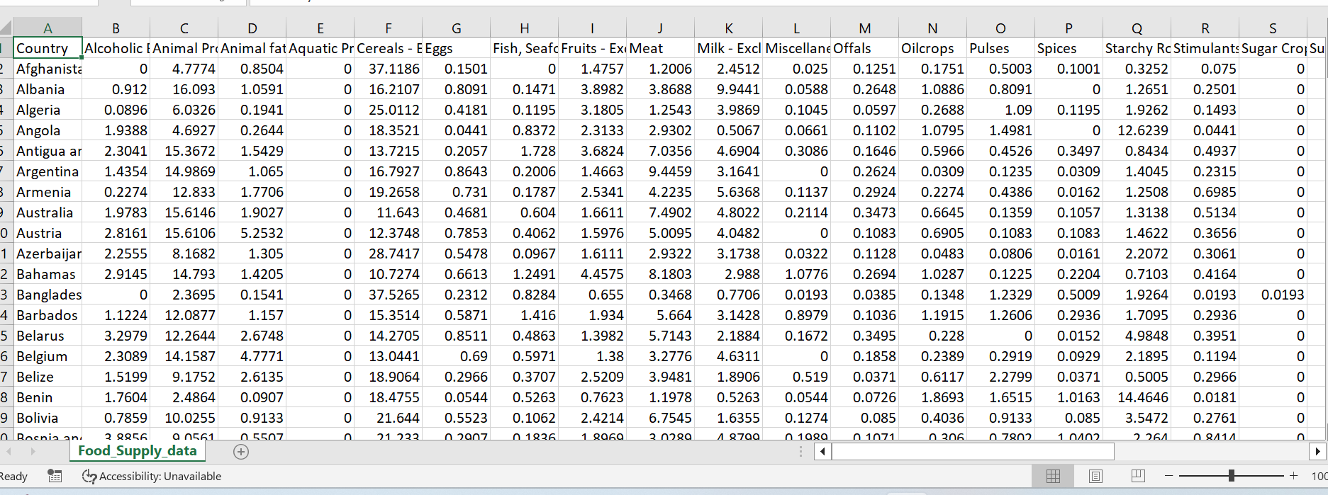
Dataset :: A_group135 Name of Student Presenting: ………………………..

